Slide 1
Naïve Bayer Classifier for Spam Comment Detection
Adilet Masalbekov :301283691 Arcan Caglayan : 301316211
Muhammed Ikbal , Ekinci :301309283

Slide 2
Purpose of the Project,Overview of the Navie Bayes Classification Method
Purpose of the Project is to classify Youtube comments as a spam or non spam using the Naïve Bayers Classification Method ,
Here is the overview of the Naïve Bayes Classification Method - Importing the MultinominalNB Class
The ‘MultinonminalNB’ class is impirted fron Scikit-learns’s ‘naïve_bayes’ module: “from sklearn.naive_bayes import MultinomialNB”

Slide 3

Fitting the Classifier to the Training Data, Performing Cross-Validation, Predicting Labels for the Test Set

Slide 4
Data Loading and Basic Exploration
Data Source: UCI Machine Learning Repository. .Dataset :’Youtube01-Psy.csv’
Data Loading : “data = pd.read_csv('path_to_dataset')
data_info = data.info()”
Data Preprocessing: Remove stopwords Using NLTK , Convert text to token counts with CountVectorizer and Applied TF-IDF transformation: ” vectorizer = CountVectorizer(stop_words=stopwords.words('english'))
content_transformed = vectorizer.fit_transform(content)
tfidf_transformer = TfidfTransformer()
content_tfidf = tfidf_transformer.fit_transform(content_transformed)”

Slide 6
Model training and Evaluation
Training the Classifier using Multinomial Naviye Bayes Classifier on preprocessed data : “nb_classifier = MultinomialNB()
nb_classifier.fit(train_features, train_labels)
“ Model evaluation by performing 5-fold cross validiation and Evaluating model’s generalization capability:
“cv_scores = cross_val_score(nb_classifier, train_features, train_labels, cv=5)
mean_cv_score = cv_scores.mean()”

Slide 7
Testing and Results
Testing the Model (75 to 25):
Applied the trained classifier to the test data
Asses model performance :
“predicted_labels = nb_classifier.predict(test_features)
test_accuracy = accuracy_score(test_labels, predicted_labels)“ Results
Test accuracy 95.45% : This Results shows that our model is very effective at detecting spam comments “conf_matrix = confusion_matrix(test_labels, predicted_labels)
print("Confusion Matrix:\n", conf_matrix)’’

Slide 8
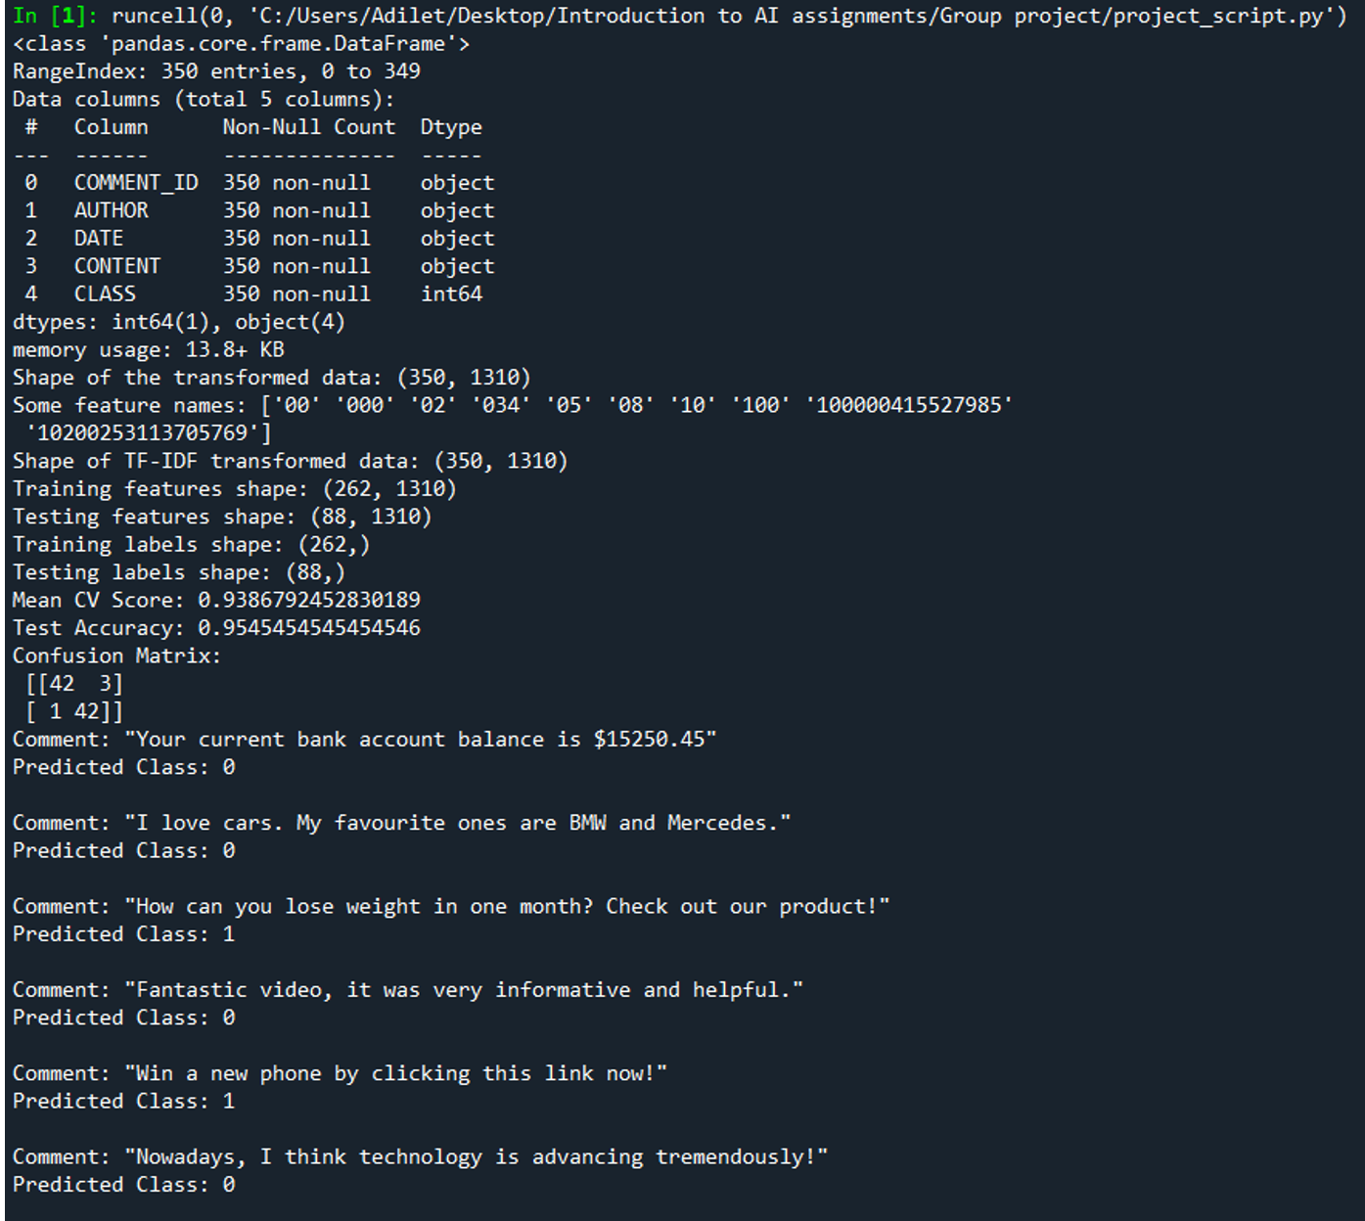
The output of the program.

Slide 9
Model Testing with Custom Comments
Applying Model to New Data: We Classified custom comments (both spam and non-spam), then demonstrate :
“new_comments_predictions = nb_classifier.predict(new_comments_tfidf)
for comment, prediction in zip(new_comments, new_comments_predictions):
print(f'Comment: "{comment}"\nPredicted Class: {prediction}\n’)“

Slide 10
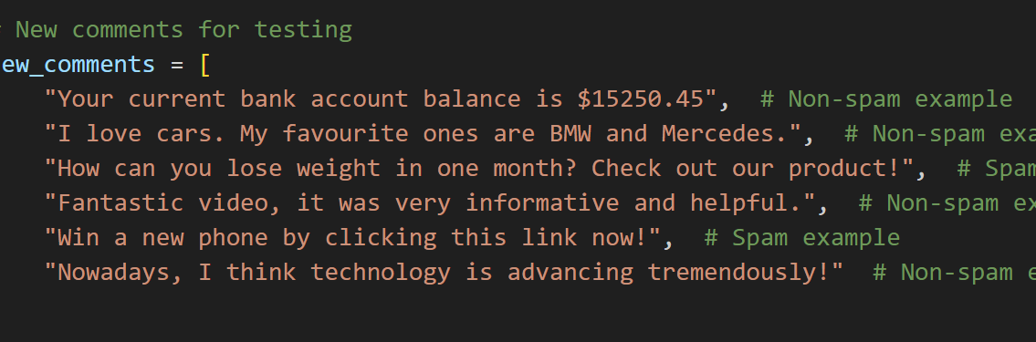
Custom Comments

Slide 11

Conclusions
Summar of Findings : Th Naïve Bayes Classifer effectively distinguishes between spam and non-spam comments with High accuracy on both testing and training phases
Project Highligts :Demonstrates robust test classification capabilities of Naïve Bayes on detecting spam and non-spam comments in a very effective way.

Slide 12

Q&A
Thank you For Listening

